Slide 1
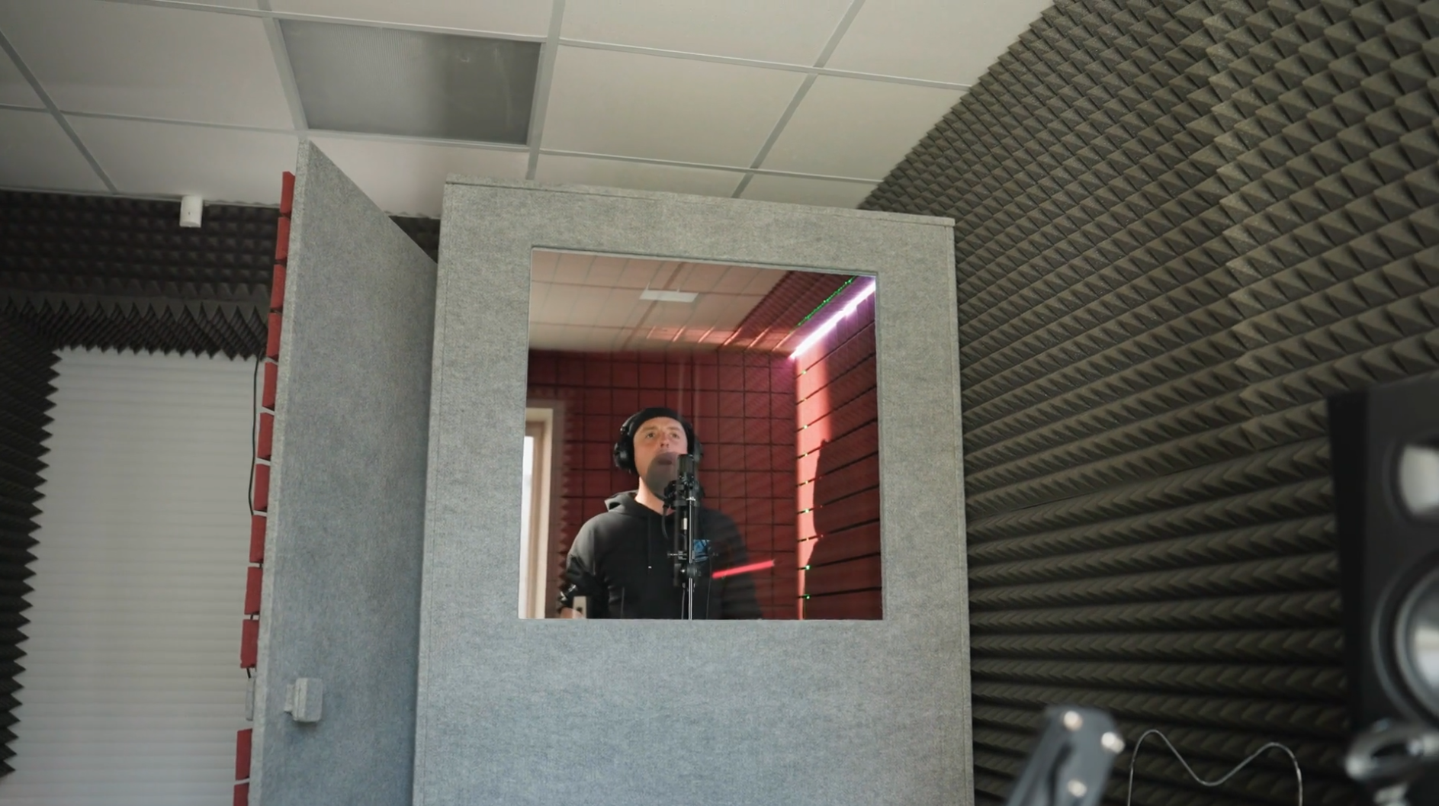
Acoustic Enclosures
Infinite panels
Tyler Dare

Slide 2





Transmission loss
When two rooms are connected, transmission loss quantifies how much sound power moves between them.
$$TL=−10 \log_{10}\left(τ\right)$$
$$τ=\frac{W_{transmitted}}{W_{incident}}$$
$$V_{2},S_{2}, {\overline{α}}_{2}$$
$$V_{1},S_{1}, {\overline{α}}_{1}$$
Partition: $TL,$ $S_{p}$
Source
$$L_{W_{1}}, D_{θ}$$

Slide 3

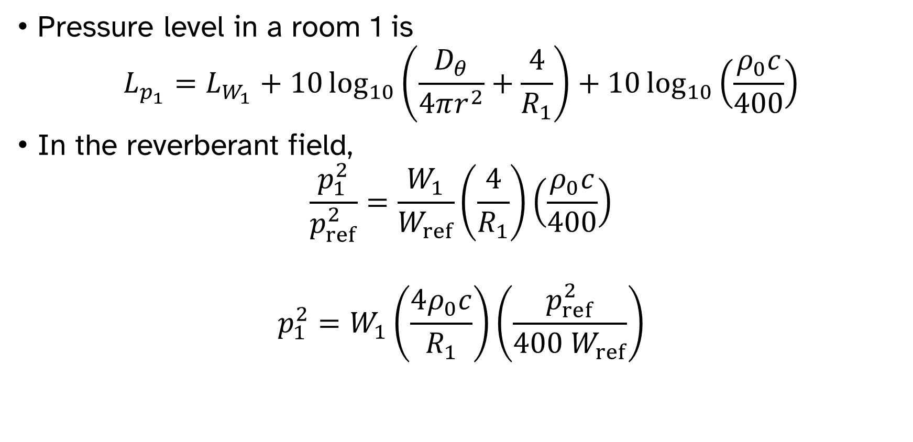

Transmission loss
Pressure level in a room 1 is
$$L_{p_{1}}=L_{W_{1}}+10\log_{10}\left(\frac{D_{θ}}{4πr^{2}}+\frac{4}{R_{1}}\right)+10\log_{10}\left(\frac{ρ_{0}c}{400}\right)$$
In the reverberant field,
$$\frac{p_{1}^{2}}{p_{ref}^{2}}=\frac{W_{1}}{W_{ref}}\left(\frac{4}{R_{1}}\right)\left(\frac{ρ_{0}c}{400}\right)$$
$$p_{1}^{2}=W_{1}\left(\frac{4ρ_{0}c}{R_{1}}\right)\left(\frac{p_{ref}^{2}}{400 W_{ref}}\right)$$
$$V_{1},S_{1}, {\overline{α}}_{1}$$
Source
$$L_{W}, D_{θ}$$

Slide 4


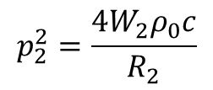

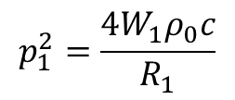
Transmission loss
$$p_{1}^{2}=\frac{4W_{1}ρ_{0}c}{R_{1}}$$
$$p_{2}^{2}=\frac{4W_{2}ρ_{0}c}{R_{2}}$$
$$V_{2},S_{2}, {\overline{α}}_{2}$$
$$V_{1},S_{1}, {\overline{α}}_{1}$$
Source
$$L_{W}, D_{θ}$$

Slide 5

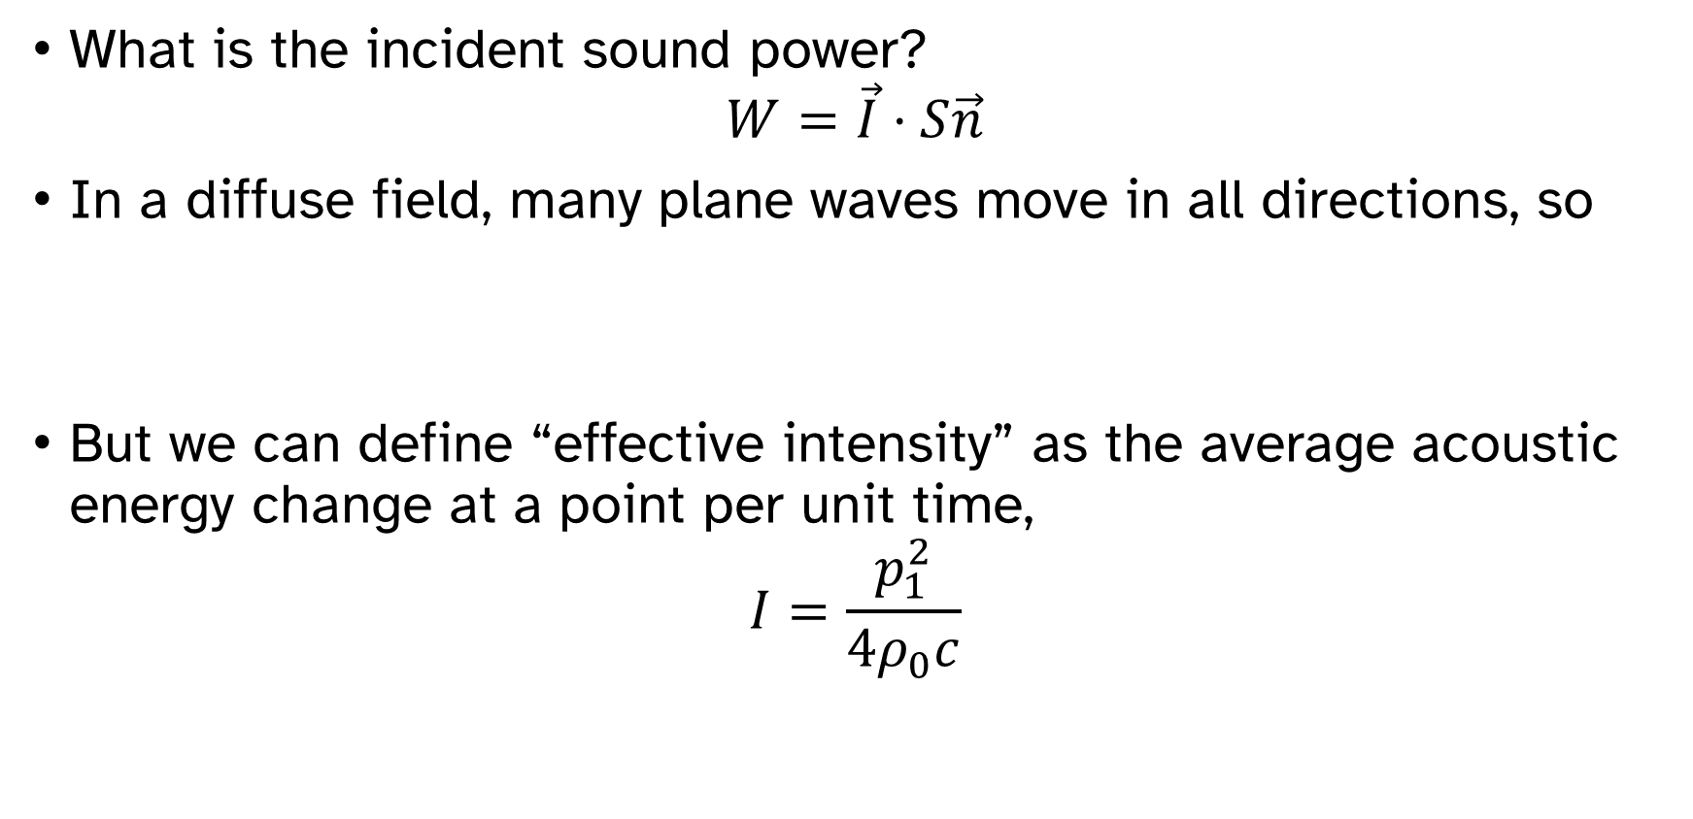


Transmission loss
What is the incident sound power?
$$W=\vec{I}⋅S\vec{n}$$
In a diffuse field, many plane waves move in all directions, so
But we can define “effective intensity” as the average acoustic energy change at a point per unit time,
$$I=\frac{p_{1}^{2}}{4ρ_{0}c}$$
$$V_{1},S_{1}, {\overline{α}}_{1}$$
Partition: $TL,$ $S_{p}$
Source
$$L_{W}, D_{θ}$$

Slide 6

Transmission loss
$$τ=\frac{W_{transmitted}}{W_{incident}}=\frac{W_{2}}{\frac{p_{1}^{2}S_{p}}{4ρ_{0}c}}$$
$$W_{2}=\frac{p_{1}^{2}S_{p}τ}{4ρ_{0}c}$$
$$p_{2}^{2}=\frac{4W_{2}ρ_{0}c}{R_{2}}=p_{1}^{2}τ\left(\frac{S_{p}}{R_{2}}\right)$$

Slide 7

Transmission loss
$$L_{p_{2}}=L_{p_{1}}+10\log_{10}{τ}+10\log_{10}\left(\frac{S_{p}}{R_{2}}\right)$$
$$NR=L_{p_{1}}−L_{p_{2}}=TL−10\log_{10}\left(\frac{S_{p}}{R_{2}}\right)$$
$$V_{2},S_{2}, {\overline{α}}_{2}$$
$$V_{1},S_{1}, {\overline{α}}_{1}$$
Partition: $TL,$ $S_{p}$
Source
$$L_{W_{1}}, D_{θ}$$

Slide 8
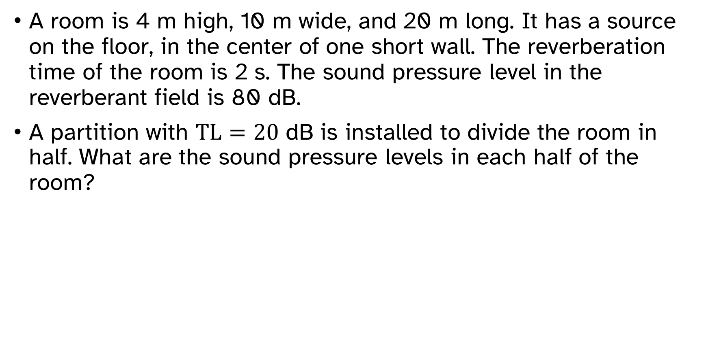
Example problem: noise reduction and transmission loss
A room is 4 m high, 10 m wide, and 20 m long. It has a source on the floor, in the center of one short wall. The reverberation time of the room is 2 s. The sound pressure level in the reverberant field is 80 dB.
A partition with $TL=20$ dB is installed to divide the room in half. What are the sound pressure levels in each half of the room?

Slide 9
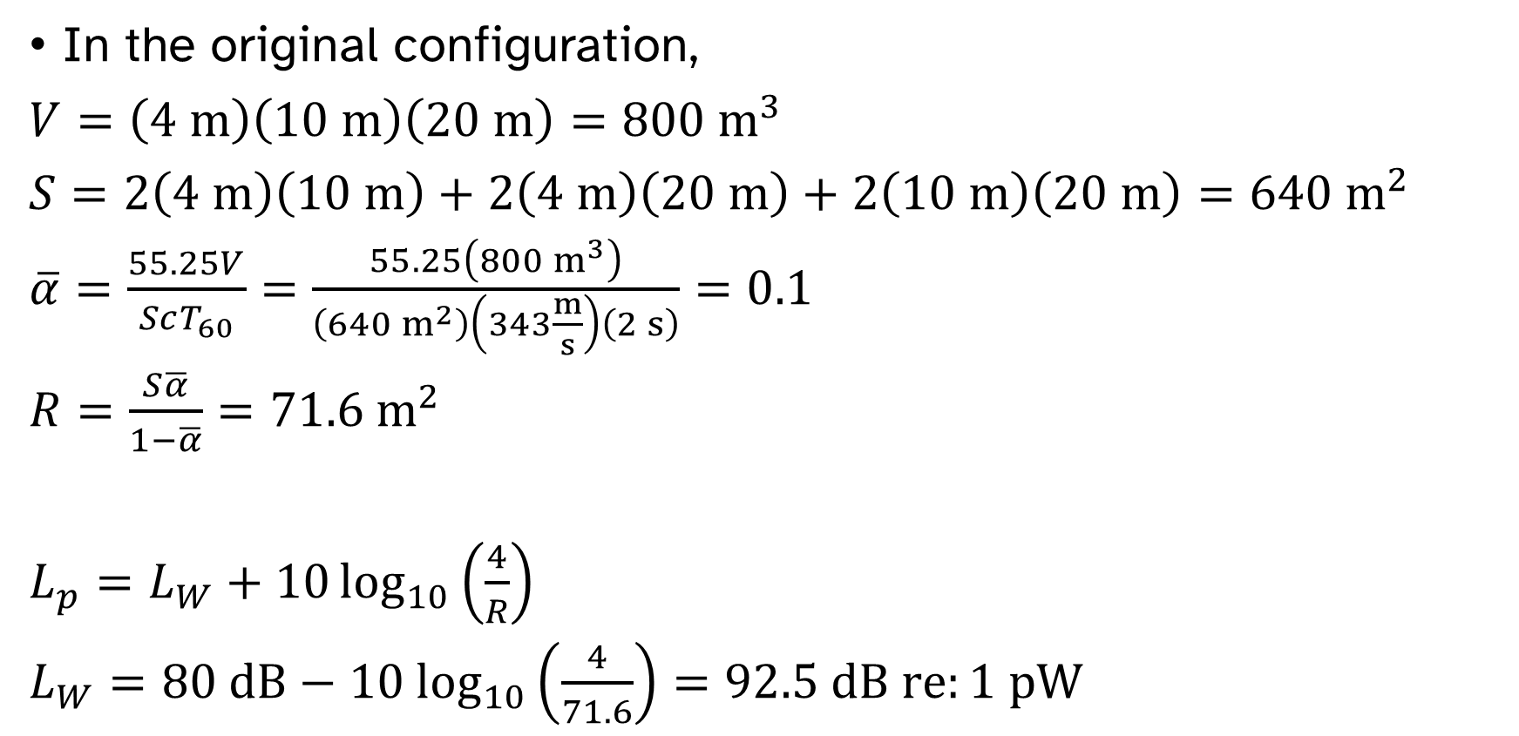
Example problem: noise reduction and transmission loss
In the original configuration,
$V=\left(4 m\right)\left(10 m\right)\left(20 m\right)=800 m^{3}$
$S=2\left(4 m\right)\left(10 m\right)+2\left(4 m\right)\left(20 m\right)+2\left(10 m\right)\left(20 m\right)=640 m^{2}$
$\overline{α}=\frac{55.25V}{ScT_{60}}=\frac{55.25\left(800 m^{3}\right)}{\left(640 m^{2}\right)\left(343\frac{m}{s}\right)\left(2 s\right)}=0.1$
$R=\frac{S\overline{α}}{1−\overline{α}}=71.6 m^{2}$
$L_{p}=L_{W}+10\log_{10}\left(\frac{4}{R}\right)$
$L_{W}=80 dB−10 \log_{10}\left(\frac{4}{71.6}\right)=92.5 dB re:1 pW$

Slide 10
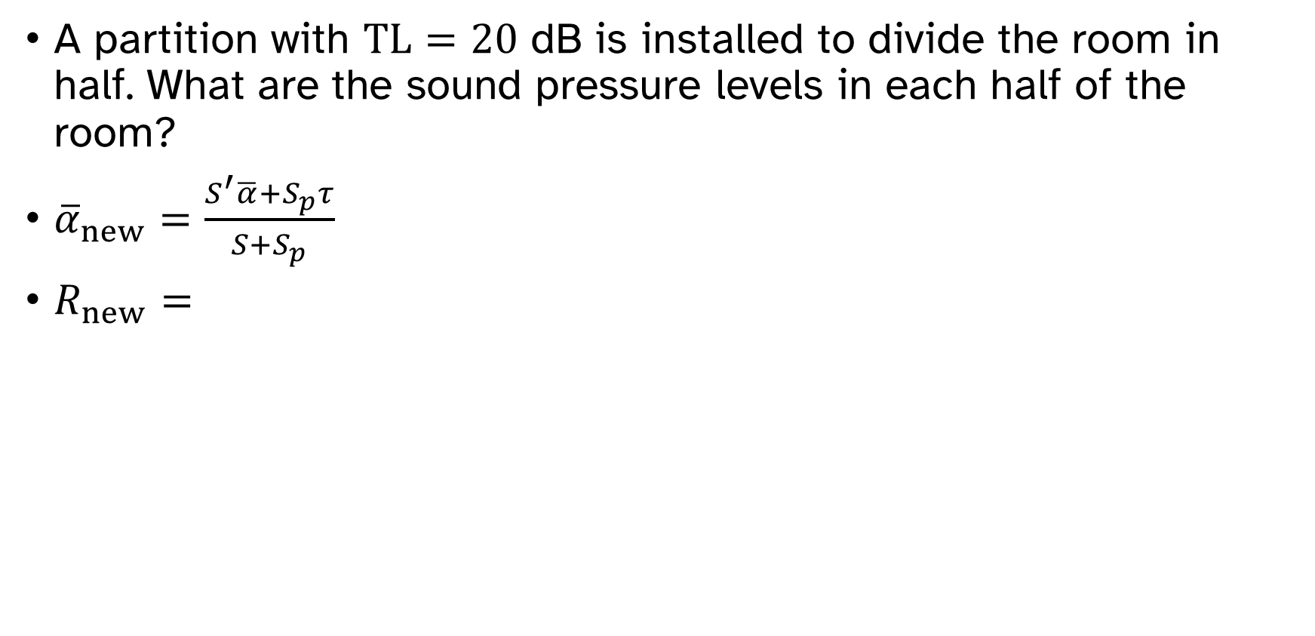
Example problem: noise reduction and transmission loss
A partition with $TL=20$ dB is installed to divide the room in half. What are the sound pressure levels in each half of the room?
${\overline{α}}_{new}=\frac{S^{′}\overline{α}+S_{p}τ}{S+S_{p}}$
$R_{new}=$

Slide 11
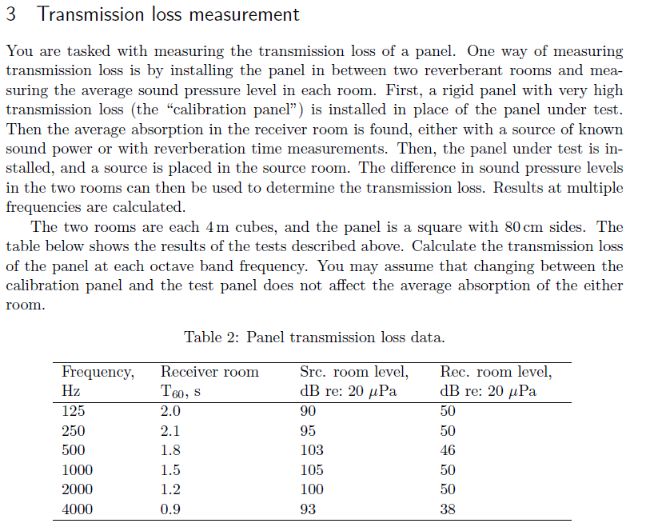

Slide 12
Transmission loss is very complicated
Transmission loss of a partition depends on many factors, including
Material and geometry of the partition
Mounting conditions
Leaks
Angle of incidence of sound

Slide 13
TL of infinite, rigid panel

Slide 14
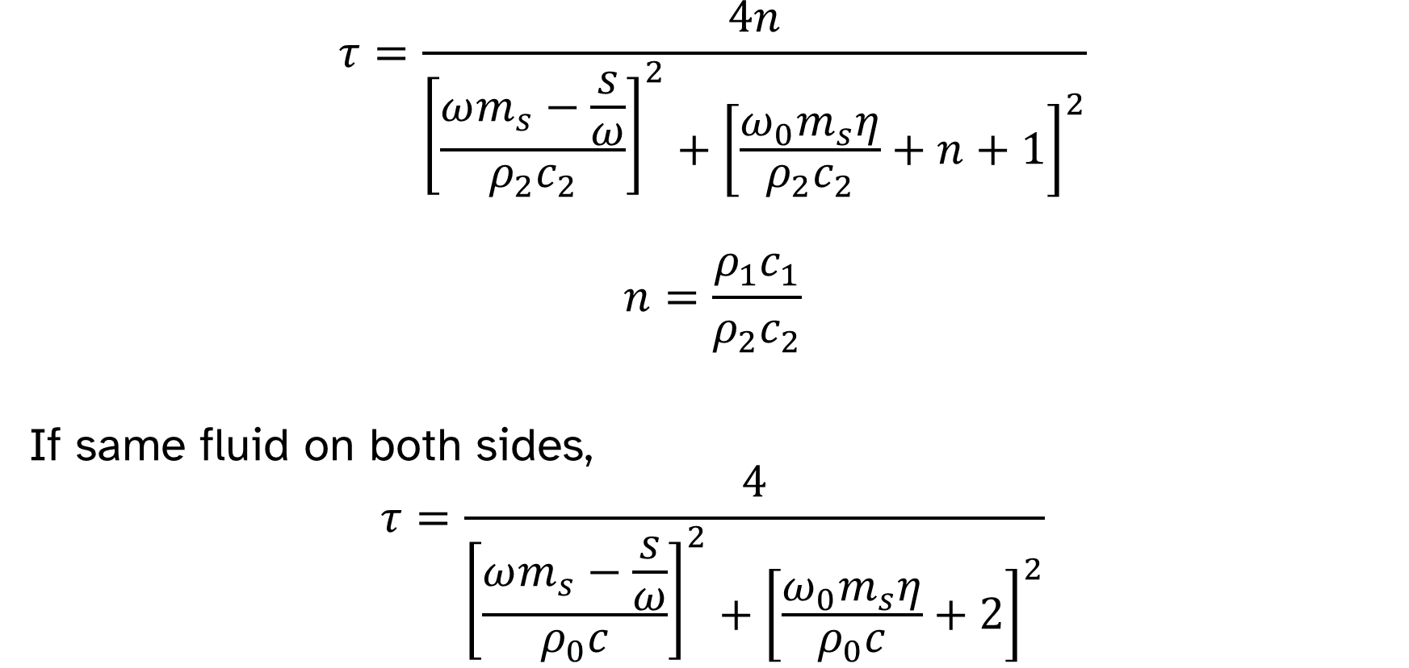
TL of infinite, rigid panel
$$τ=\frac{4n}{{\left[\frac{ωm_{s}−\frac{s}{ω}}{ρ_{2}c_{2}}\right]}^{2}+{\left[\frac{ω_{0}m_{s}η}{ρ_{2}c_{2}}+n+1\right]}^{2}}$$
$$n=\frac{ρ_{1}c_{1}}{ρ_{2}c_{2}}$$
If same fluid on both sides,
$$τ=\frac{4}{{\left[\frac{ωm_{s}−\frac{s}{ω}}{ρ_{0}c}\right]}^{2}+{\left[\frac{ω_{0}m_{s}η}{ρ_{0}c}+2\right]}^{2}}$$

Slide 15
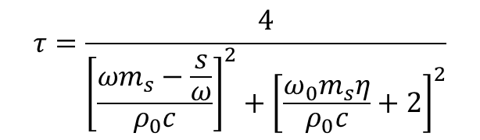
TL of infinite, rigid panel
$$τ=\frac{4}{{\left[\frac{ωm_{s}−\frac{s}{ω}}{ρ_{0}c}\right]}^{2}+{\left[\frac{ω_{0}m_{s}η}{ρ_{0}c}+2\right]}^{2}}$$

Slide 16
TL of infinite, rigid panel
$$τ=\frac{4}{{\left[\frac{ωm_{s}−\frac{s}{ω}}{ρ_{0}c}\right]}^{2}+{\left[\frac{ω_{0}m_{s}η}{ρ_{0}c}+2\right]}^{2}}$$

Slide 17
TL of infinite, rigid panel
$$τ=\frac{4}{{\left[\frac{ωm_{s}−\frac{s}{ω}}{ρ_{0}c}\right]}^{2}+{\left[\frac{ω_{0}m_{s}η}{ρ_{0}c}+2\right]}^{2}}$$

Slide 18
TL of infinite, rigid panel
$$τ=\frac{4}{{\left[\frac{ωm_{s}−\frac{s}{ω}}{ρ_{0}c}\right]}^{2}+{\left[\frac{ω_{0}m_{s}η}{ρ_{0}c}+2\right]}^{2}}$$

Slide 19
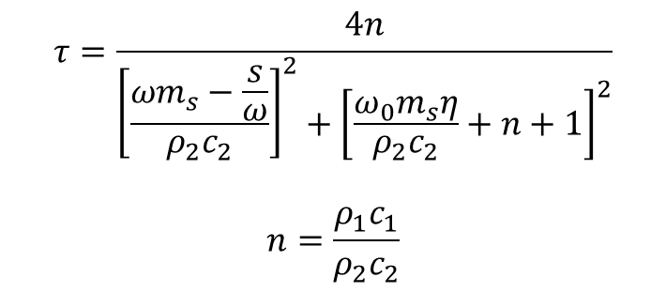
TL of infinite, rigid panel
$$τ=\frac{4n}{{\left[\frac{ωm_{s}−\frac{s}{ω}}{ρ_{2}c_{2}}\right]}^{2}+{\left[\frac{ω_{0}m_{s}η}{ρ_{2}c_{2}}+n+1\right]}^{2}}$$
$$n=\frac{ρ_{1}c_{1}}{ρ_{2}c_{2}}$$

Slide 20
TL of infinite, rigid panel
$$τ=\frac{4}{{\left[\frac{ωm_{s}−\frac{s}{ω}}{ρ_{0}c}\right]}^{2}+{\left[\frac{ω_{0}m_{s}η}{ρ_{0}c}+2\right]}^{2}}$$

Slide 21
TL of infinite, rigid panel
$$τ=\frac{4}{{\left[\frac{ωm_{s}−\frac{s}{ω}}{ρ_{0}c}\right]}^{2}+{\left[\frac{ω_{0}m_{s}η}{ρ_{0}c}+2\right]}^{2}}$$

Slide 22
TL of infinite, rigid panel
$$τ=\frac{4}{{\left[\frac{ωm_{s}−\frac{s}{ω}}{ρ_{0}c}\right]}^{2}+{\left[\frac{ω_{0}m_{s}η}{ρ_{0}c}+2\right]}^{2}}$$

Slide 23
TL of infinite, rigid panel
$$τ=\frac{4}{{\left[\frac{ωm_{s}−\frac{s}{ω}}{ρ_{0}c}\right]}^{2}+{\left[\frac{ω_{0}m_{s}η}{ρ_{0}c}+2\right]}^{2}}$$

